Slide 1
Image classification using tensorflow
Abdullah al khaled
Shlomo bauer

Slide 2
Outline
Deep Learning Frameworks
TensorFlow vs. Keras
CNN Basics
Keras Sequential Model
Example Code

Slide 3
Deep Learning frameworks
*https://towardsdatascience.com/battle-of-the-deep-learning-frameworks-part-i-cff0e3841750

Slide 4
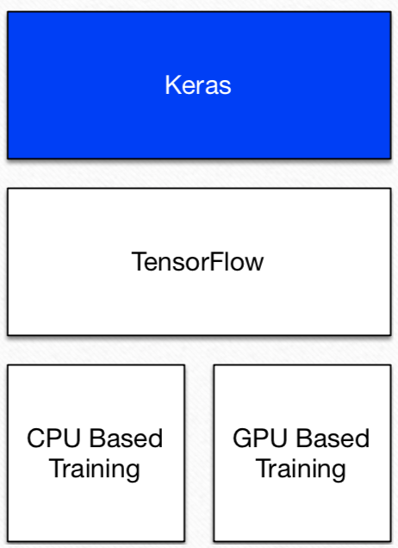
Tensorflow & keras
TensorFlow is GPU accelerated library for optimizing and automating tensor applications; support DL
It has programming model allowing for relatively easy development of DL
Google pedigree, widely used, good GUI tools, good GPU support
Keras is a powerful and easy-to-use DL library for Theano & TensorFlow; provides a high-level neural networks API to develop and evaluate DL models.
https://pbs.twimg.com/media/DTWS9YvU0AEBERf.jpg

Slide 5
CNN basics
INPUT => CONV => RELU => POOL => CONV => RELU => POOL => FC => RELU => FC => OUTPUT
http://ncia.snu.ac.kr/xe/files/attach/images/1629/629/001/e4d5173d88de64115b3ae994e2391206.png

Slide 6
Steps: 4 major steps
Step 1: Convolution
Step 2: Pooling
Step 3: Flattening
Step 4: Full connection
https://heuritech.files.wordpress.com/2016/02/vgg16.png

Slide 7
CNN Operations
http://upload.chinaz.com/2015/1112/1447291311578.jpg

Slide 8
CNN Operations contd

Slide 9
Popular CNN Architectures
LeNet-5 (Yann LeCun, 1998): 3 layers
AlexNet (2012): 7 layers
Clarifai (2013): Refinement of AlexNet, 7 layers
VGGNet (2104): 16 layers
Network in network (NiN) [2014]
GoogLeNet (2104): 19 layers
ResNet (2015): 152 layers
Inception v2, v3, v4 (2016)

Slide 10
Popular CNN Architectures Contd
LeNet-5
AlexNet

Slide 11
Popular CNN Architectures Contd
NiN
ResNet

Slide 12
Keras Sequential model
Keras sequential model is a linear stack of layers.
You can create it by passing a list of layer instances to the constructor:
Layers can also be added by simply using the .add() method:
from keras.models import Sequential
from keras.layers import Dense, Activation
model = Sequential(
[Dense(32, input_shape=(784,)), Activation('relu'),
Dense(10), Activation('softmax'), ])
model = Sequential()
model.add(Dense(32, input_dim=784)) model.add(*Activation('relu'))

Slide 13
Specifying input shape
The model needs to know what input shape it should expect.
Only 1st layer needs to receive information about its input shape.
There are several possible ways:
Pass an input_shape to the 1st layer. The batch dimension is not included.
Some 2D layers, such as Dense, support specifying their input shape via input_dim, and some 3D temporal layers support input_dim and input_length.

Slide 14
Compilation
Before training a model, we need to configure the learning process, done by the compile method. It receives 3 arguments:
Optimizer: This could be the string identifier of an existing optimizer (such as rmsprop or adagrad), or an instance of the Optimizer class.
Loss function: This is the objective that the model will try to minimize. It can be the string identifier of an existing loss function (such as categorical_crossentropy or mse), or it can be an objective function.
List of metrics: For any classification problem you will want to set this to metrics = ['accuracy']. A metric could be a custom metric function.

Slide 15
Compilation
# For a multi-class classification problem
model.compile(optimizer='rmsprop', loss='categorical_crossentropy', metrics=['accuracy'])
# For a binary classification problem
model.compile(optimizer='rmsprop', loss='binary_crossentropy', metrics=['accuracy'])
# For a mean squared error regression problem
model.compile(optimizer='rmsprop', loss='mse')
# For custom metrics
import keras.backend as K
def mean_pred(y_true, y_pred):
return K.mean(y_pred)
model.compile(optimizer='rmsprop', loss='binary_crossentropy', metrics=['accuracy', mean_pred])

Slide 16
Training
Keras models are trained on Numpy arrays of input data and labels.
For model training, you will typically use the fit function.
fit(self, x=None, y=None, batch_size=None, epochs=1, verbose=1, callbacks=None, validation_split=0.0, validation_data=None, shuffle=True, class_weight=None, sample_weight=None, initial_epoch=0, steps_per_epoch=None, validation_steps=None)

Slide 17
Evaluate & predict
Computes the loss on some input data, batch by batch.
evaluate(self, x=None, y=None, batch_size=None, verbose=1, sample_weight=None, steps=None)
Generates output predictions for the input samples.
The input samples are processed batch by batch.
predict(self, x, batch_size=None, verbose=0, steps=None)

Slide 18
Example code: 1

Slide 19
Example code: 2

Slide 20
Example code: 3

